Slide 1





Status_upd 9-25-25

Slide 2

Hello!
I am Javier Napoles
SOC Analyst
You can find me at @Jnapfx
Notes:
Hi, I’m Javier Napoles. I’m originally from Venezuela, and I’ve been living in Stamford for about five years.
I’m a graphic designer currently transitioning into the field of cybersecurity, combining my creativity and problem-solving skills with a passion for technology and security.

Slide 3
What is a SOC Analyst?
Real time Security Monitoring
SOC analysts continuously monitor network traffic, security alerts, and system logs to detect potential cyber threats in real-time. They serve as the first line of defense, analyzing over 10,000 security alerts daily to identify genuine threats from false positives.
Incident Response & Protection
They respond immediately to security incidents, containing threats, investigating breaches, and implementing recovery procedures. SOC analysts are critical for maintaining organizational security posture and preventing cyber attacks from causing significant damage.

Slide 4
Why I chose this path?
Personal Motivation & Background
My background in graphic design has given me a unique perspective on problem-solving and creative thinking. This project combines my passion for technology with my desire to prevent cyber threats and protect organizations from digital attacks.
Creative Problem Solving
Applying design thinking principles to cybersecurity challenges, developing innovative approaches to threat detection and network security architecture for comprehensive protection.
Technical Implementation
Combining analytical skills with hands-on technical expertise to build and deploy effective security monitoring systems and incident response procedures.
Notes:
From Design to Cybersecurity: I bring creativity and problem-solving from my graphic design background.
Driven by Purpose: My goal is to stop cyber threats and protect people and organizations.
My Strengths:
🔹 Creative Thinking – Finding innovative ways to detect and prevent attacks.
🔹 Hands-On Skills – Building real systems for monitoring and response.

Slide 5

About my project

Slide 6









Divide & Defend:
“A Hands-On SOC Lab Project with Micro-Segmentation”
Notes:
This project simulates the core responsibilities of a SOC Analyst by building a functional lab environment using virtual machines and open-source tools. It emphasizes practical skills in threat detection, alert triage, and incident response. A key focus is the use of micro-segmentation as a proactive defense strategy to enhance network security.

Slide 7






Tools used in the Project
Virtualizations & OS Platforms
UTM for virtual machine management and network simulation
Parrot OS as security-focused agents for monitoring
Kali Linux for penetration testing and attack simulation
Detection & Visualization Tools
Wazuh SIEM for comprehensive treat detection and analysis
Grafana for real-time dashboard visualization and monitoring
Discord for automated notification delivery and incident alerts

Slide 8
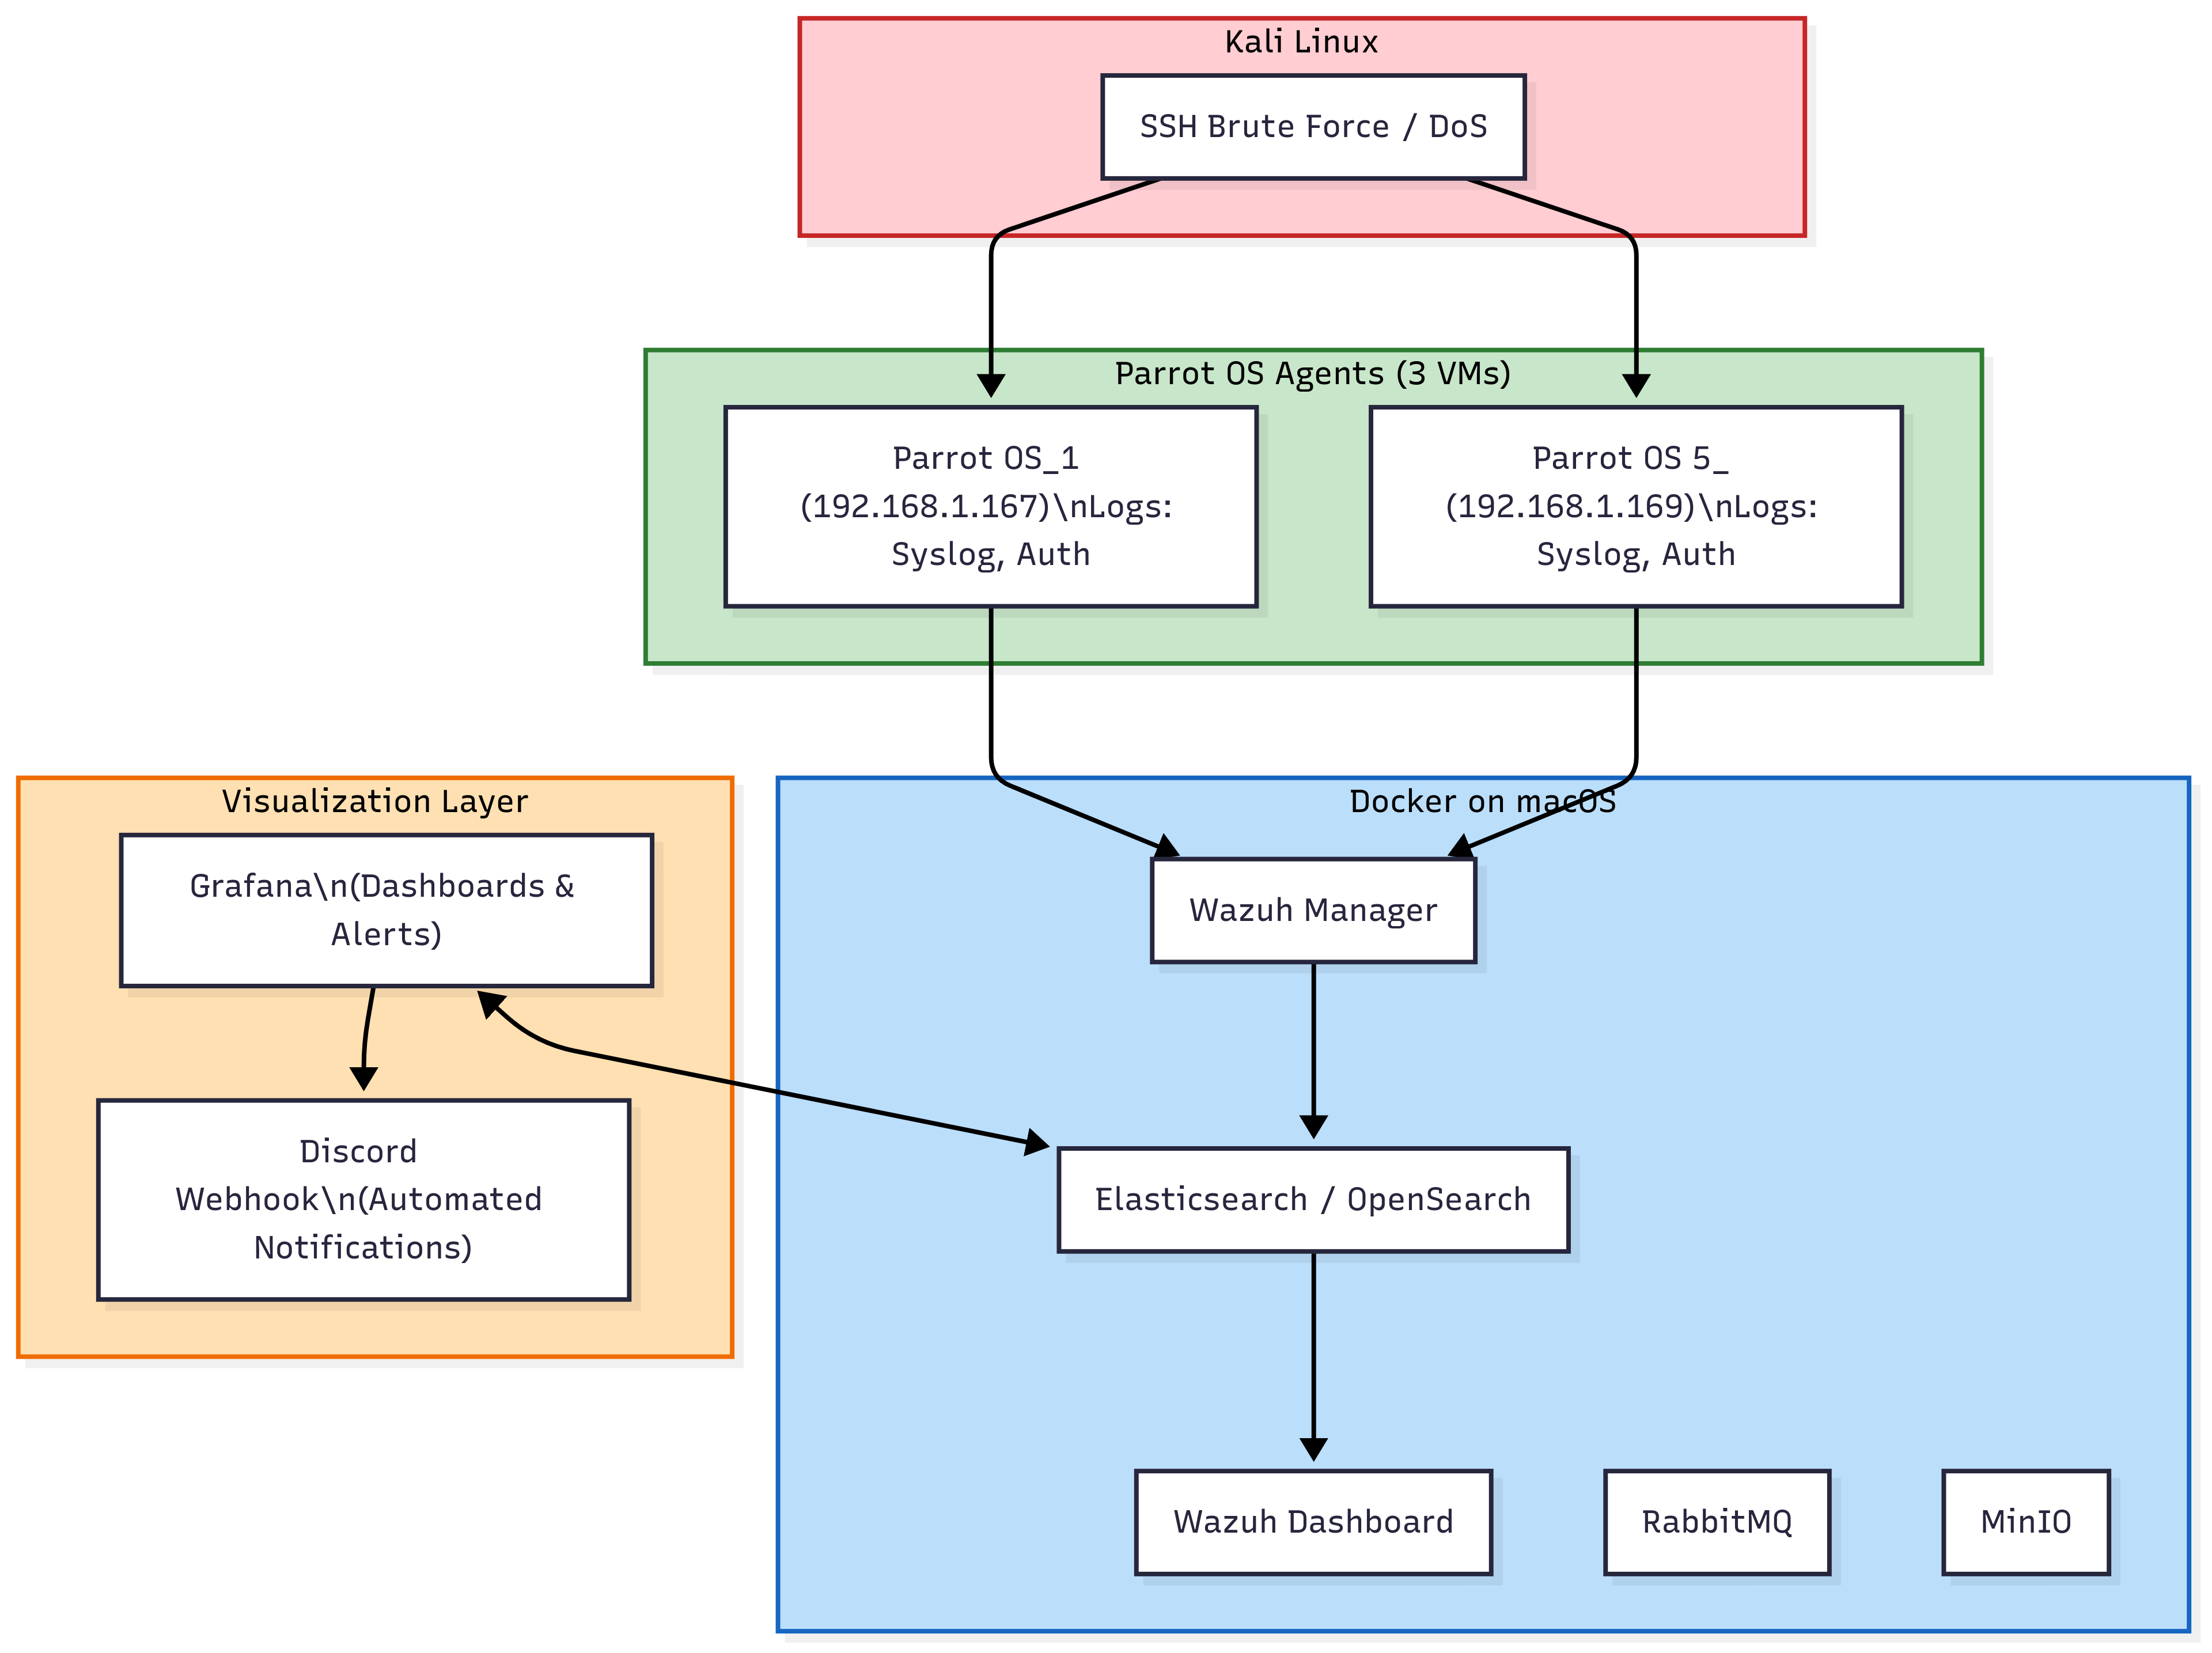
Project Diagram
Notes:
Parrot OS Agents → These are the machines generating logs (syslog and auth).
Kali Linux → Represents the attacker launching SSH brute force or DoS attacks.
Docker on macOS → Runs the main Wazuh services:
Wazuh Manager receives logs from the VMs.
Elasticsearch stores and allows querying of events.
Wazuh Dashboard provides a graphical interface to view alerts.
RabbitMQ and MinIO are support components for Wazuh.
Grafana → Connects to Elasticsearch to display real-time dashboards and metrics.
Discord Webhook → Sends automated notifications when critical alerts occur.
In short:
The agents send logs → Wazuh processes them → Elasticsearch stores them → Grafana and the Wazuh Dashboard display them → if critical alerts are detected, they are sent to Discord.

Slide 9
SOC Implementation Work Process
Design Network Architecture
Install Security Agents
Generate Wazuh Alerts
1
3
5
2
4
6
Deploy Virtual Machines
Simulate Attack Scenarios
Display Grafana Dashboards
Notes:
Design Network Architecture – Planned a micro-segmented network to isolate critical systems and reduce attack surface.
Deploy Virtual Machines – Set up UTM environment and deployed VMs for security roles and network segments.
Install Security Agents – Configured Parrot OS agents for endpoint monitoring and data collection.
Simulate Attacks – Used Kali Linux for penetration testing and validation of security controls.
Generate Wazuh Alerts – Tuned Wazuh SIEM to detect threats and create real-time alerts.
Visualize in Grafana – Built dashboards to track security metrics, incidents, and system health.

Slide 10
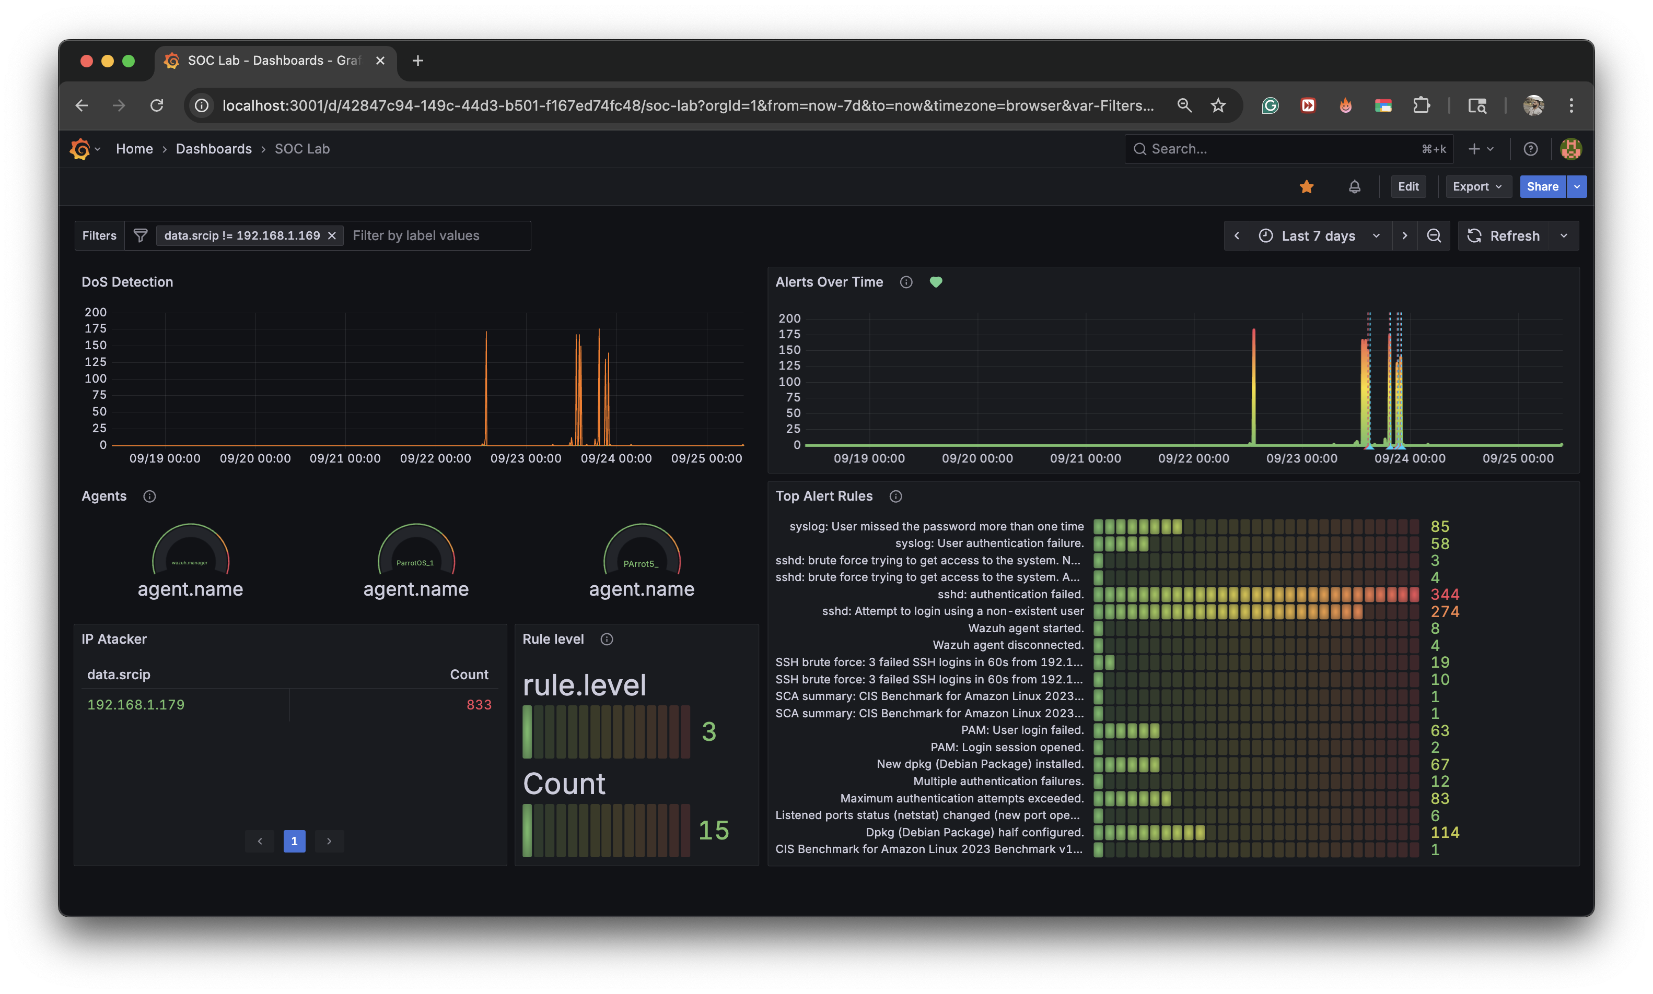
New Technology implemented: Grafana
Real-Time
Dashboard
Incident Timeline
Tracking
Agent Status
Monitoring
Notes:
Real-Time Dashboards
Grafana provides comprehensive real-time visualization of security metrics, threat indicators, and system performance data for immediate situational awareness.
Incident Timeline Tracking
Advanced timeline visualization shows the progression of security incidents, enabling better forensic analysis and incident response coordination.
Agent Status Monitoring
Comprehensive monitoring of all security agents across the network, ensuring continuous coverage and alerting on any communication failures.

Slide 11
Final Results: Mini SOC Achievement
Fully operational SOC
Successfully implemented a complete Mini SOC capable of real-time threat detection, automated alert generation, and comprehensive security monitoring across all network segments.
Advanced Attack Detection
Achieved sophisticated attack detection capabilities using Wazuh SIEM, successfully identifying multiple attack vectors, suspicious activities, and security vulnerabilities during testing phases.
Seamless Tool Integration
Established perfect integration between Grafana visualization platform and Wazuh SIEM, creating a unified security operations environment with automated data correlation and reporting.

Slide 12
2. Extra Resources
For Business Plans, Marketing Plans, Project Proposals, Lessons, etc

Slide 13
Quotations are commonly printed as a means of inspiration and to invoke philosophical thoughts from the reader.

Slide 14




Extra resources

Slide 15
SOC Implementation Work Process
Generate Wazuh Alerts
Configured Wazuh SIEM to process security events and generate real-time alerts for detected threats and anomalies.
Design Network Architecture
Planned and designed the network topology with micro-segmentation to isolate critical systems and limit attack surfaces effectively.
Install Security Agents
Configured Parrot OS agents across network segments for comprehensive monitoring and data collection from all endpoints.
1
3
5
2
4
6
Deploy Virtual Machines
Set up UTM virtualization environment and deployed multiple VMs for different security roles and network segments.
Simulate Attack Scenarios
Used Kali Linux to perform controlled penetration testing and attack simulations to validate security controls.
Display Grafana Dashboards
Created comprehensive Grafana dashboards to visualize security metrics ,incident timelines, and system health status.
Notes:
1) Design Network Architecture
Planned and designed the network topology with micro-segmentation to isolate critical systems and limit attack surfaces effectively.
2) Deploy Virtual Machines
Set up UTM virtualization environment and deployed multiple VMs for different security roles and network segments.
3) Install Security Agents
Configured Parrot OS agents across network segments for comprehensive monitoring and data collection from all endpoints.
4) Simulate Attack Scenarios
Used Kali Linux to perform controlled penetration testing and attack simulations to validate security controls.
5) Generate Wazuh Alerts
Configured Wazuh SIEM to process security events and generate real-time alerts for detected threats and anomalies.
6) Display Grafana Dashboards
Created comprehensive Grafana dashboards to visualize security metrics ,incident timelines, and system health status.

Slide 16
SlidesCarnival icons are editable shapes. This means that you can:
Resize them without losing quality.
Change fill color and opacity.
Change line color, width and style.
Isn’t that nice? :) Examples:
Find more icons at slidescarnival.com/extra-free-resources-icons-and-maps

Slide 17
Diagrams and infographics

